Slide 1
8690 Final Report
-Digit Recognizer
github.com/wxqk3/Digit-Recognizer_Deep_Learning
Team member:
Weiliang Xia
© 2016 by The Curators of the University of Missouri, a public corporation

Slide 2
Content
Motivation
Project topic
Input Data Output data baseline methods for comparison. Approaches

Slide 3

Motivation
1.Continue car license recognition project
from matlab machine learning knn to python deep learning
2.Learn python
3.Learn deep Learning
4.Choose a similar and small dataset for my pool Mac OS
Kaggle competition
MNIST -DATASET
Notes:
I chose this topic from Kaggle because I have a previous research about car license recognition in machine learning methods, knn. In matlab
And this dataset is small and good for my mac

Slide 4

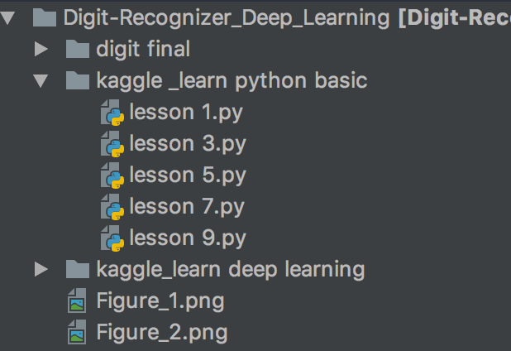

Timelines
1.First week I finished the kaggle python basic
2.Second week I finished the Kaggle deep learning course
3.Third week I finished the first approach
Notes:
I chose this topic from Kaggle because I have a previous research about car license recognition in machine learning methods, knn.
And this dataset is small and good for my mac

Slide 5
Project Topic
Digit Recognizer
MNIST ("Modified National Institute of Standards and Technology") is the basic dataset of computer vision. Since its release in 1999, this classic dataset of handwritten images has served as the basis for benchmarking classification algorithms.
Notes:
I chose this topic from Kaggle because I have a previous research about car license recognition in machine learning methods, knn. In matlab
And this dataset is small and good for my mac

Slide 6
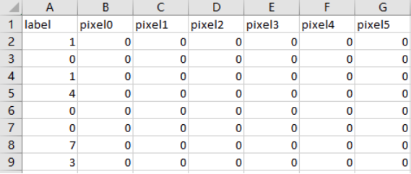
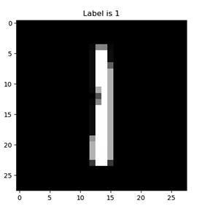
Input data
Two csv files
Train.csv (42000, 784) with 1 label column and 1 define row
Test.csv (28000, 784) only with 1 more define row I use pyplot to visualize

Slide 7
Goals and output
The goal in this competition is to take an image of a handwritten single digit,
and determine what that digit is.
Metric
This competition is evaluated on the categorization accuracy of your predictions
(the percentage of images you get correct).
Submission File Format
The file should contain a header and have the following format:
ImageId,Label 1,0 2,0

Slide 8
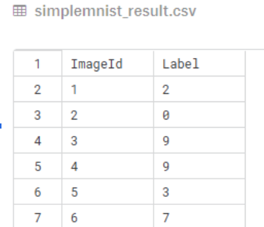
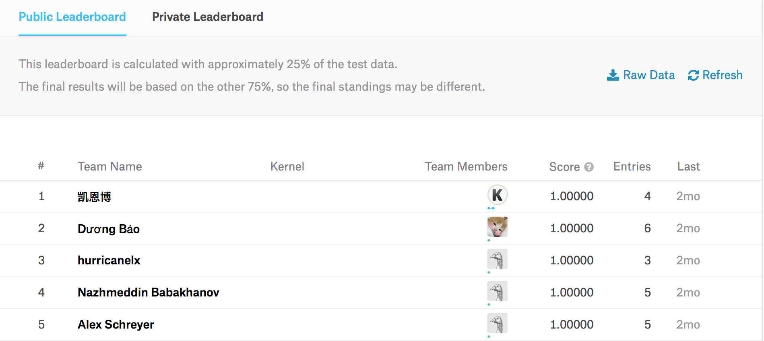
Baseline methods
I Choose the best results from kaggle LeaderBoard as the baseline comparison: which has 100% accuracy

Slide 9
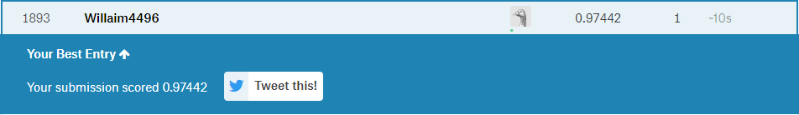
Previous Approach
First approach:
In -> [[Conv2D,relu]*2 -> Flatten -> [Dense,relu] -> [Dense,softmax] ->Out
Rank 1893 and I have the accuracy of 97.4% (1893 out of 2943, top 64%)

Slide 10
Final Approach
In -> [Conv2D,relu]*2 -> MaxPool2D -> Dropout(0.25)
-> [Conv2D,relu]*2 -> MaxPool2D -> Dropout(0.25)
-> [Dense,relu] -> [Dense,softmax] ->Out
For the final approach, I have the accuracy of 98%

Slide 11
Thanks!

